Slide 1



Green Pace
Security Policy Presentation
Developer: Andrew Nelson
"Security is a process, not a product.“ — Bruce Schneier
Notes:
Welcome to the Green Pace Security Policy Presentation. In this presentation, I will explain the secure coding policies developed for Green Pace, highlight critical vulnerabilities, and show how automation helps keep security strong through every phase of development.

Slide 2


OVERVIEW: DEFENSE IN DEPTH
The Green Pace Security Policy was made to help protect our software from new threats that happen as technology grows. As more people join the team, it is important to have clear rules, so everyone stays on the same page and builds secure code. Without a strong policy, it would be easy to miss things that hackers could use to attack us. This policy makes sure we think about security right from the start, not just at the end. It follows the defense in depth idea by adding many layers of protection, like secure coding, testing tools, encryption, and system checks, to make our software safer.
Notes:
The Green Pace Security Policy was made to help protect our software from new threats that happen as technology grows. As more people join the team, it is important to have clear rules so everyone stays on the same page and builds secure code. Without a strong policy, it would be easy to miss things that hackers could use to attack us. This policy makes sure we think about security right from the start, not just at the end. It follows the defense-in-depth idea by adding many layers of protection, like secure coding, testing tools, encryption, and system checks.

Slide 3


THREATS MATRIX
Likely Unchecked input values: If user input is not checked, attackers can send bad data to crash or control the system. Uninitialized pointers: A pointer that is not set can cause random behavior or crashes. Unsafe type conversions: Changing one type of data into another without checking can lead to wrong results or crashes. | Priority Unsafe string functions: Attackers can overflow buffers and take control of the system. SQL injection: Attackers can steal or change data in the database by sending bad input. Bad memory management: Poor handling of memory can cause crashes, leaks, or allow attackers to take over the system. Dangling pointers: Using memory that was already freed can lead to crashes or hacks.
Low priority Unsafe assertion use: Assertions usually only cause issues in testing or debug builds, not in the live program. Poor exception handling: If exceptions are not handled properly, it may skip over errors, but the system usually stays running. | Unlikely Integer overflows: These are harder to pull off if input is checked properly, but they can still cause crashes or open security holes if missed.
AUTOMATION TOOLS
Cppcheck:
Helps catch memory and integer problems
Clang Tidy:
Helps catch bad pointer use and type errors
SonarQube:
Helps detect SQL injections
Notes:
In the Threats Matrix, we identified our top priority risks: string handling errors, SQL injection, memory management errors, and integer overflows. These are serious because they can crash programs, expose data, or open the door for attacks. Likely risks include bad value validation and dangling pointers, and we marked things like data type errors and assertion misuse as lower priorities. To help catch these vulnerabilities early, we use three key tools: Cppcheck finds memory and integer problems during development, Clang Tidy catches bad pointer use and risky type conversions, and SonarQube identifies security issues like SQL injection vulnerabilities. These tools are automated to run during coding and building, helping us fix problems before they reach production.

Slide 4
10 PRINCIPLES
1. Validate Input Data: Data Type Errors, Data Value Validation, String Handling Errors, SQL Injection
2. Heed Compiler Warnings: Data Type Errors, String Handling Errors, Pointer Initialization Errors, Exception Handling Errors
3. Architect and Design for Security Policies: Data Type Errors, Data Value Validation, String Handling Errors, Memory Management Errors, Exception Handling Errors, SQL Injection
4. Keep It Simple: Pointer Initialization Errors, Exception Handling Errors, Data Type Errors
5. Default Deny: Data Value Validation, SQL Injection, String Handling Errors
6. Sanitize Data Sent to Other Systems: SQL Injection, String Handling Errors
7. Adhere to Principle of Least Privilege: Exception Handling Errors, SQL Injection
8. Practice Defense in Depth: Data Type Errors, String Handling Errors, Memory Management Errors, SQL Injection, Dangling Pointers
9. Use Effective Quality Assurance Techniques: Integer Overflow, Memory Management Errors, Pointer Initialization Errors, Dangling Pointers
10. Adopt a Secure Coding Standard: Applies to all coding standards
Notes:
Our security policy follows ten important principles that guide us in how we write and review code. These principles include validating all input, listening to compiler warnings, designing systems with security in mind, keeping code simple to avoid hidden bugs, defaulting to deny unsafe input, sanitizing any data we send to external systems, using least privilege so users only have the access they need, practicing defense in depth by layering protections, using quality assurance techniques like code reviews and testing, and following a consistent secure coding standard. Every coding standard we built ties back to one or more of these principles, making sure our defenses are strong at every level of development.

Slide 5
CODING STANDARDS
Priority - Most Critical to Least:
The coding standards are ranked based on the potential impact and likelihood of a real attack.
SQL Injection is ranked first because it can completely expose or destroy a database with very little effort.
String Handling Errors and Memory Management Errors are next because they are the most common causes of buffer overflows and crashes in C++ programs.
Integer Overflow and Dangling Pointers are critical because they can easily lead to memory corruption if not controlled.
Exception Handling and Data Validation are important but slightly less immediate threats if other defenses are strong.
Pointer Initialization and Data Type Errors can cause crashes but are easier to catch during testing.
Bad Assertion Use is last because it mostly affects development builds and is less of a direct threat in production.
SQL Injection
String Handling Errors
Memory Management Errors
Integer Overflow
Dangling Pointers
Exception Handling Errors
Data Value Validation
Pointer Initialization Errors
Data Type Errors
Bad Assertion Use
Notes:
When we prioritized the coding standards, we focused first on the risks that could cause the most damage. SQL Injection was ranked highest because it could allow attackers to take control of our database with a simple input. String handling errors were next because they often cause buffer overflows, which are serious vulnerabilities. Memory management errors and integer overflows followed, because they can crash programs and open backdoors into the system. We addressed lower priority issues like assertion misuse and data type confusion after we secured the high-risk areas. Our goal was to tackle the most dangerous vulnerabilities first, reducing the biggest risks early.

Slide 6
ENCRYPTION POLICIES
Encryption in Flight Data is encrypted while it is being sent over a network such as the internet or a local connection. This protects user logins, form submissions, and service calls. All data sent over the network must use HTTPS or other secure communication protocols to stop attackers from stealing or changing data during transmission.
Encryption at Rest Data is protected while it is stored on a hard drive or server. This policy covers sensitive data stored in files, databases, or backups. Encryption at rest protects data if someone gains physical access to a device. All stored data must use strong and approved encryption methods.
Encryption in Use Data is protected while it is being used by a program. This applies to sensitive information in memory during processing. It is harder to do but important because data in memory can be leaked if it is dumped or read. Best practices include isolating memory and using secure containers.
Notes:
We use encryption at every major point where data can be exposed. When data moves over the network, like during logins or data transfers, it’s protected with HTTPS and TLS to prevent interception. When data is stored on our servers or databases, it’s encrypted at rest so that even if someone steals a device, they cannot access the information. For data in use, while it’s being processed in memory, we use isolation techniques and best practices to make sure sensitive data is not accidentally leaked or exposed to unauthorized parts of the system. These layers of encryption work together to protect information from every angle.

Slide 7
TRIPLE-A POLICIES
Authentication Users must prove their identity using strong authentication methods. This includes username and password combinations and require multi factor authentication. Authentication prevents unauthorized users from accessing systems.
Authorization After authentication, users are granted specific access rights. Users can only access data and functions they are allowed to use. Permissions must be reviewed and updated as users change roles.
Accounting All user actions must be recorded in secure logs. This includes logging access to files, changes to settings, and account modifications. Reviewing logs helps find unusual activity and investigate security issues.
Notes:
Authentication, Authorization, and Accounting are at the core of how we control access to our systems. Authentication makes sure users are who they say they are, using strong passwords and multi-factor authentication. Authorization limits what users can do once they are logged in, only giving them access to the resources they need for their role. Accounting keeps track of everything users do by creating secure logs, which help us find suspicious activity or investigate if something goes wrong. Together, these policies help us control, monitor, and protect access to sensitive data and critical systems.

Slide 8

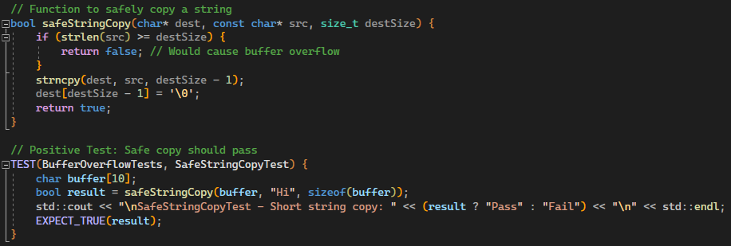
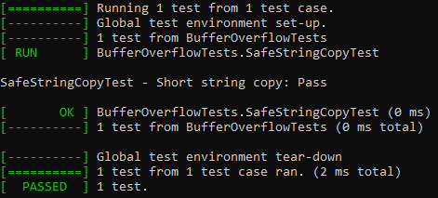
Unit Testing: Safe String Copy
Notes:
As part of our secure coding plan, we added unit tests to catch vulnerabilities early. We focused on the biggest risks we identified earlier. First, we tested Safe String Copy to make sure short strings copied safely into buffers without overflow.

Slide 9
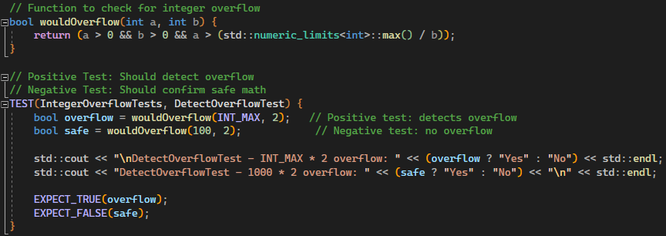
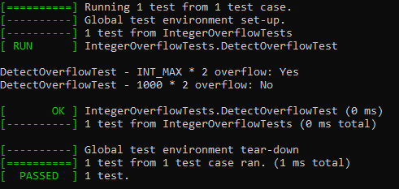
Unit Testing: Integer Overflow
Notes:
Next, we tested for Integer Overflow, checking that unsafe math gets caught while normal math works fine.

Slide 10
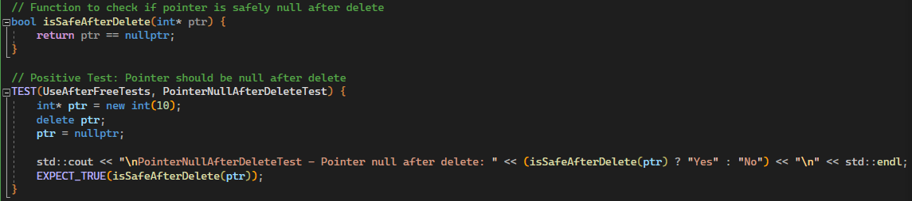
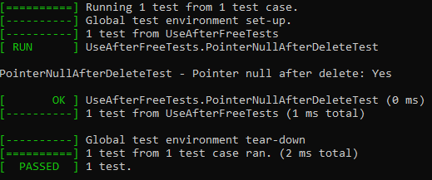
Unit Testing: Use After Free
Notes:
We also tested Use After Free, making sure pointers are set to null after memory is deleted to avoid dangling pointer problems.

Slide 11
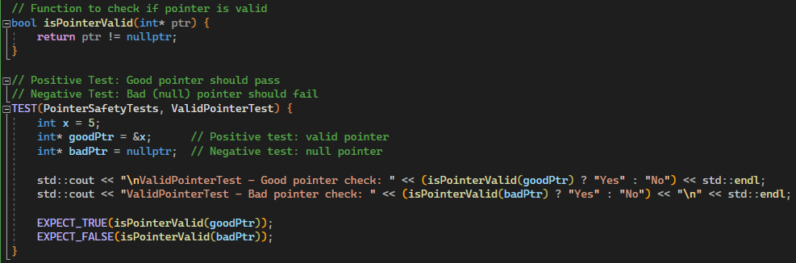
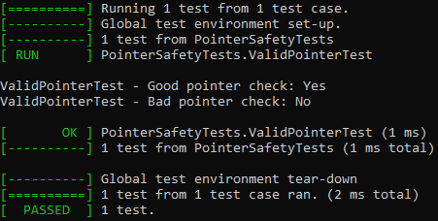
Unit Testing: Null Pointer Dereference
Notes:
Finally, we tested Null Pointer Dereference, verifying that good pointers pass, and bad pointers are caught.
We used GoogleTest to automate all these tests and show pass or fail results after every build. To take it further, we could add fuzz testing to send random inputs at the code and find hidden bugs. We could also expand unit tests to cover edge cases like empty inputs or oversized values.

Slide 12


AUTOMATION SUMMARY
During the Design stage, security tools like Cppcheck and Clang Tidy are planned.
The compiler is first used in the Build stage with security flags enabled. During the Build stage, the compiler uses stack protection and runs static analysis automatically.
During Verify and Test, GoogleTest unit tests check for memory, input, and pointer safety.
In the Transition stage, penetration tests and configuration reviews are automated.
Finally, in Monitor, logs and alerts are automatically collected and analyzed.
DevSecOps Pipeline:
Security is built into every phase of development, testing, and deployment.
Problems are caught early instead of after coding is finished.
Automation helps lower risk and keeps systems secure throughout the project.
Notes:
Security automation is built into every stage of the DevSecOps pipeline. During the Design stage, we plan security tools like Cppcheck and Clang Tidy to catch issues early. At the Build stage, the compiler adds security protections like stack protection and warnings and runs static analysis automatically. In the Verify and Test stage, GoogleTest unit tests check memory safety, input validation, and pointer handling. During the Transition stage, penetration testing and security configuration checks are automated. In the Monitor stage, logs and alerts are collected to watch for attacks or failures after deployment.

Slide 13
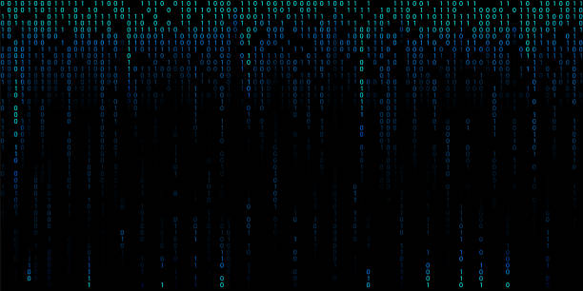
RISKS AND BENEFITS
Problems: Vulnerabilities found too late cause expensive damage.
Solutions: Use static analysis, automated unit tests, and quick patches.
Risks if you wait: Higher attack risk, higher costs, system instability.
Benefits if you act now: Early fixes save time, money, and protect reputation.
Notes:
When vulnerabilities are found too late, they cause expensive damage. Systems may crash, data may leak, and repairs become complicated. The solution is to use static analysis tools like Cppcheck and Clang Tidy, run automated unit tests with GoogleTest, and fix vulnerabilities early with fast patches. If we wait, we risk higher costs, greater chances of being attacked, and more instability. If we act now, we save time, money, and protect our systems and reputation.

Slide 14

RECOMMENDATIONS
Continue using static analysis (Cppcheck, Clang Tidy) during all stages of development, not just at the start.
Expand unit testing with GoogleTest to cover more edge cases like empty inputs, maximum string lengths, and invalid pointers.
Add fuzz testing tools later to automatically throw random inputs at your code and find hidden bugs.
Apply security settings at the compiler level for every project (stack protection, bounds checking, warnings as errors).
Automate penetration testing before moving any system into production.
Review and update the security policy every 6 months to keep up with new threats.
Notes:
Our recommendations are clear. Continue using static analysis tools like Cppcheck and Clang Tidy throughout all stages of development. Expand unit testing with GoogleTest to cover more edge cases, like empty inputs, maximum string lengths, and invalid pointers. Add fuzz testing tools to automatically throw random inputs at the code to find hidden bugs. Make sure the compiler uses strong security settings like stack protection and warnings-as-errors. Automate penetration testing before every release. And review and update our security policies every six months to stay ahead of new threats.

Slide 15
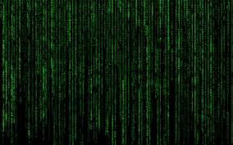
CONCLUSIONS
Fixing vulnerabilities early saves time, money, and protects the company's reputation.
Secure coding is not a one-time event, it must be part of every design, build, and testing cycle.
Tools like static analysis, unit testing, fuzzing, and log monitoring make security automatic, reliable, and scalable.
Following this plan will protect users, defend data, and build stronger systems in the future.
Notes:
In conclusion, fixing vulnerabilities early saves time, reduces costs, and protects the company’s reputation. Secure coding is not a one-time event. It must be part of every design, build, and testing cycle. Using static analysis, unit testing, fuzz testing, and log monitoring makes security automatic and reliable. Following this plan will protect our users, defend our data, and build stronger systems in the future.

Slide 16

REFERENCES
Cppcheck. (n.d.). https://cppcheck.sourceforge.io/
Extra clang tools 21.0.0git documentation. Clang. (n.d.). https://clang.llvm.org/extra/clang-tidy/
GoogleTest user’s guide. GoogleTest. (n.d.). https://google.github.io/googletest/
Seacord, R. C. (2013-03-23). Secure Coding in C and C++, 2nd Edition. [[VitalSource Bookshelf version]]. Retrieved from vbk://9780132981972
Sei cert C++ coding standard. SEI CERT C++ Coding Standard - SEI CERT C++ Coding Standard - Confluence. (n.d.). https://wiki.sei.cmu.edu/confluence/pages/viewpage.action?pageId=88046682
SonarQube Server Automates Code Quality and security reviews. Clean Code: Writing Clear, Readable, Understandable & Reliable Quality Code. (n.d.). https://www.sonarsource.com/products/sonarqube/

